Slide 1

Business Contract Validation
Presented by :
Team Hustle squad
Dept of Computer Science & Engineering

Slide 2
Team members :
Registration No(s) Name
BU21CSEN0100861 A. Sarayu Reddy
BU21CSEN0100880 M. Keerthi Varshini
BU21CSEN0100908 P. Sayed Sab Vali
BU21CSEN0101229 V. Bhanu Teja Sahu
BU21CSEN0101648 K. Preethi
Dept of Computer Science & Engineering

Slide 3
PROBLEM STATEMENT
Business Contract Validation –
To Classify Content within the Contract Clauses and Determine Deviations from Templates and highlight them.When validating a business contract by classifying content within clauses and identifying deviations from templates, the process involves meticulous scrutiny. Each clause is categorised according to its purpose, such as defining obligations, specifying terms, or outlining responsibilities. By comparing these clauses against established templates or standard industry practices, any discrepancies or variations can be pinpointed and highlighted. This method ensures that the contract is not only comprehensive but also aligns closely with best practices, enhancing its clarity, enforceability, and legal compliance.
Dept of Computer Science & Engineering

Slide 4
ABSTRACT
Introduce an application that automates the validation of business contracts using NLP and text comparison algorithms.The application classifies contract clauses based on their content, such as obligations, responsibilities, and terms, it compares classified clauses against predefined templates to detect any deviations from standard or industry practices, the system automatically highlights any deviations, bringing attention to non-standard clauses that require further review.
The automation reduces manual effort, minimizes human error, and ensures consistent contract reviews.The solution enhances contract management by ensuring that contracts align with legal requirements and industry standards.Legal and business professionals can focus on strategic decisions rather than manual reviews, leading to better contract outcomes.The application streamlines the contract validation process, making it more efficient, reliable, and scalable
Dept of Computer Science & Engineering

Slide 5
Unique Idea Brief (Solution)
Your application idea for validating business contracts is unique because it combines advanced natural language processing (NLP) techniques with text comparison algorithms to automate a traditionally manual and time-consuming process. By classifying content within contract clauses and identifying deviations from predefined templates, your solution can enhance consistency, accuracy, and efficiency in contract reviews.
Unique Aspects:
1.NLP-Powered Classification: Using NLP, the application can accurately classify clauses based on their content (e.g.,obligations,responsibilities,terms).
2.Automated Deviation Detection:The text comparison algorithms can automatically highlight deviations from standard templates.
3.Efficiency and Consistency:By automating the review process, the application reduces the time and effort required for manual reviews while ensuring that all contracts are consistently checked against the same standards.
Dept of Computer Science & Engineering

Slide 6
Brief Solution:-
1.Clause Classification : Implement NLP models trained to understand the semantics of legal language, allowing the application to categorize each clause according to its purpose (e.g., payment terms, confidentiality, liability).
2.Template Matching: Develop a database of predefined templates and industry-standard clauses. The application compares the clauses in the contract with these templates to identify any discrepancies.
3.Deviation Highlighting: When a deviation is detected, the application highlights the difference, providing a detailed explanation of how the clause differs from the standard template.
4.User Interface : Create a user-friendly interface where legal professionals can upload contracts, review flagged deviations, and make informed decisions on whether to accept or modify the non-standard clauses.
Dept of Computer Science & Engineering

Slide 7
CHALLENGES
Complex Legal Language: Legal contracts often feature intricate and specialised terminology, which can challenge NLP algorithms when it comes to correctly interpreting and categorising clauses.
Diverse Templates: Contracts vary widely across different industries and businesses, necessitating a broad range of templates that must be regularly updated to maintain their applicability and usefulness.
Addressing Ambiguities: Detecting and resolving ambiguous language within contracts is difficult, as even minor differences in phrasing can lead to varied interpretations.
NLP Model Scalability: As the number of contracts grows, it is essential for NLP models to scale efficiently to manage large volumes of data while maintaining accuracy.
Need for Customization: Organisations often require tailored contract templates and review criteria, making it challenging to create a universally applicable solution.
Ensuring Data Security and Privacy: Managing confidential contract data demands rigorous security protocols to safeguard against data breaches and unauthorised access.
Dept of Computer Science & Engineering

Slide 8
SCOPE
Advanced NLP Techniques
Template Management and Version Control
Ambiguity Resolution
Scalable NLP Models
Customization Options
Data Privacy and Security
Integration with Existing Systems
Dept of Computer Science & Engineering

Slide 9
APPLICATIONS
1. Legal Contract Review: The application can be used by law firms and in-house legal teams to automate the review of business contracts.
2.Vendor and Client Agreement Management: Businesses can apply the tool to manage contracts with vendors and clients.
3. Real Estate Transactions: Real estate firms can leverage the application to validate property contracts ,ensuring that all clauses are in compliance with real estate laws and regulations.
4.Insurance Policy Review: Insurance companies can use the tool to analyse policy documents, ensuring that all clauses meet regulatory requirements and protecting against potential legal challenges.
5.Financial Agreements: Banks and financial institutions can apply the system to review loan agreements, investment contracts.
6.Employment Contracts: Human resources departments can use the application to standardize and validate employment contracts.
7.Intellectual Property (IP) Agreements: The application can help in reviewing IP contracts, ensuring that all clauses related to patents, trademarks, and copyrights are clear, enforceable, and legally compliant.
Dept of Computer Science & Engineering

Slide 10
Features Offered :
-PDF File Upload:
Allows users to upload PDF files of business contracts.
-Text Extraction:
Extracts text from the uploaded PDF files using PyMuPDF.
-Template Comparison:
Compares the extracted text against a predefined contract template to identify deviations.
-Clause Highlighting:
Highlights important clauses and terms within the contract text.
-Deviation Highlighting: Highlights deviations from the template in different colours for easy identification
(e.g., red for missing clauses, green for added clauses).
-Named Entity Recognition (NER):Identifies and extracts key entities (e.g., names, dates, addresses) from the contract text using spaCy.
-Web Interface: Provides a user-friendly web interface for uploading files and displaying results.
Dept of Computer Science & Engineering

Slide 11
PROCESSFLOW :
1.User Uploads Contract: The user navigates to the web application and uploads a PDF file of the business contract.
2.Text Extraction: The uploaded PDF is processed to extract its text content using the extract_text_from_pdf function, which utilises PyMuPDF.
3.Template Comparison: The extracted text is compared with a predefined template using the extract_important_contents function. The differences are highlighted to show deviations.
4.Highlighting Terms: Specific important terms and clauses within the contract text are highlighted using the highlight_contract_terms function.
5.Entity Extraction: The text is processed with spaCy to extract named entities (such as names, addresses, dates) using the extract_entities function.
6.Results Displayed: The processed text, highlighted terms, deviations, and extracted entities are displayed on the results page.
Dept of Computer Science & Engineering

Slide 12
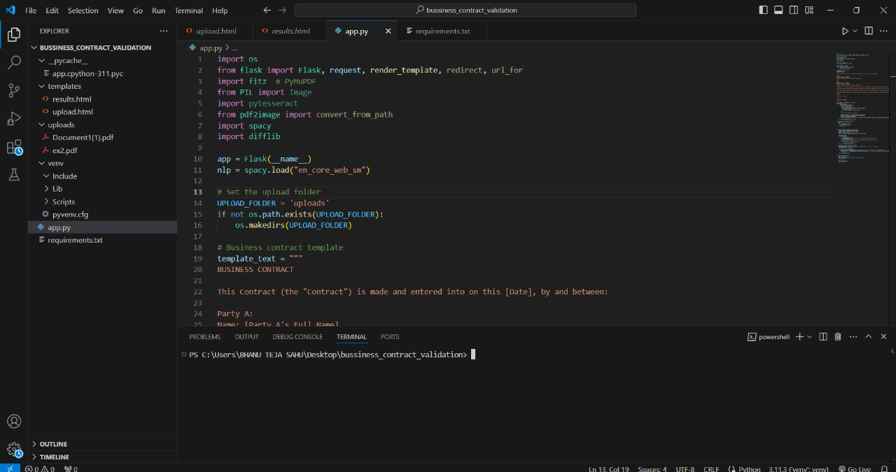
PROCESS :
1. Open the source code to validate the contract
Dept of Computer Science & Engineering

Slide 13
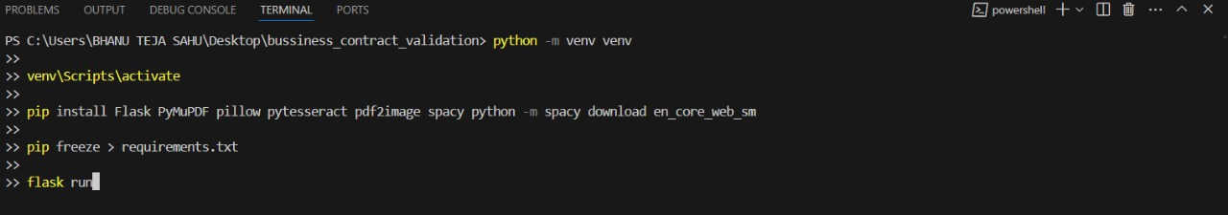
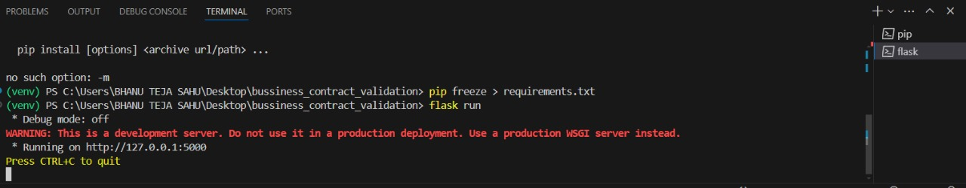
2.Install the “flask “ package using terminal, and run the code as “flask run”
3.After Run the code if you want to quit then press “CTRL+C”
Dept of Computer Science & Engineering

Slide 14
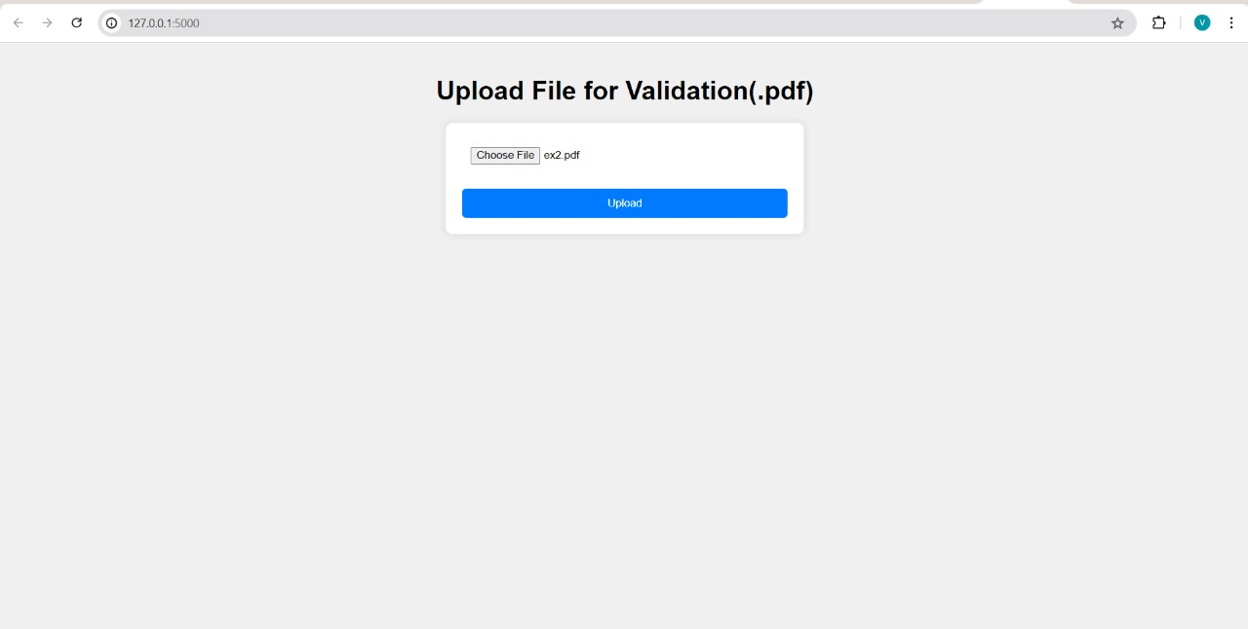
4.Upload the file in the form of pdf otherwise it won’t validate
Dept of Computer Science & Engineering

Slide 15
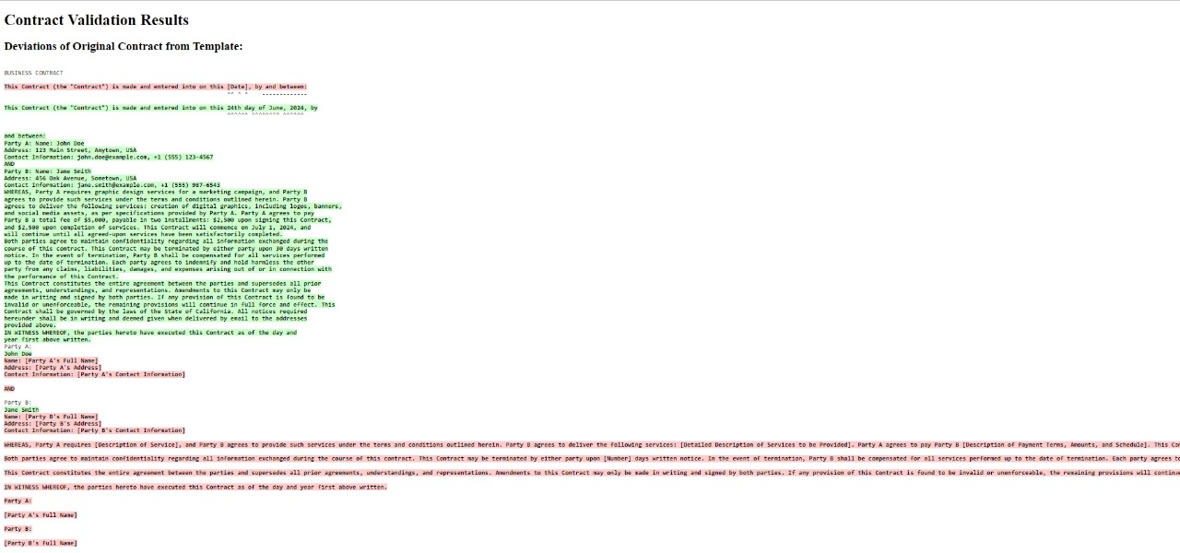
5.After uploading the file the ,It will show the deviations of Original Contract from template
Dept of Computer Science & Engineering

Slide 16
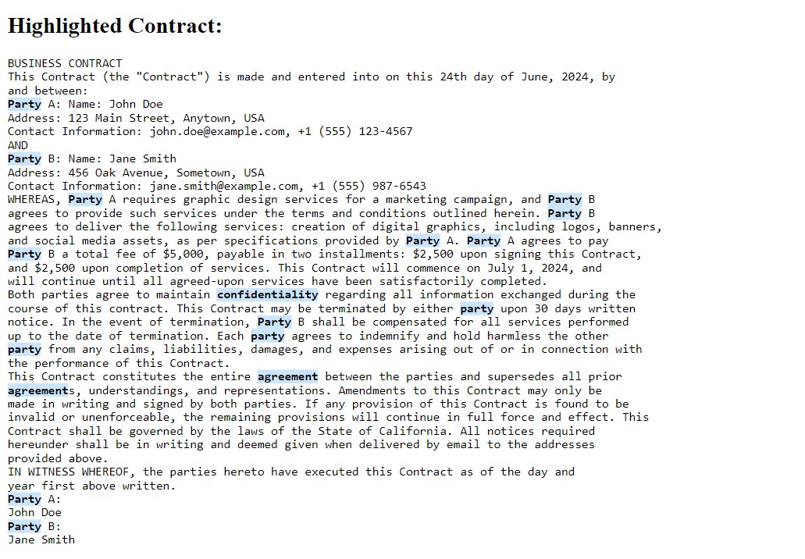
6.The contract will be Highlighted as shown in figure
Dept of Computer Science & Engineering

Slide 17
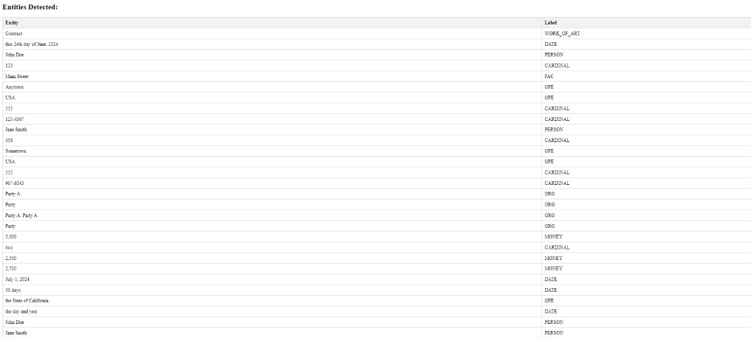
7.After Highlighting it will detect the entities
Dept of Computer Science & Engineering

Slide 18
CONCLUSION
This project demonstrates the potential of combining various technologies to solve real-world problems effectively. By automating the tedious and error-prone process of contract validation, the application not only saves time and resources but also ensures higher accuracy and reliability. The collaborative effort of the team members, each bringing their expertise to the table, has resulted in a robust and user-friendly application that meets the needs of businesses dealing with complex contracts.
The successful implementation of this project showcases the importance of integrating machine learning and natural language processing in business applications, paving the way for more innovative solutions in the future.
Dept of Computer Science & Engineering

Slide 19
Thank You
Dept of Computer Science & Engineering

